Slide 1
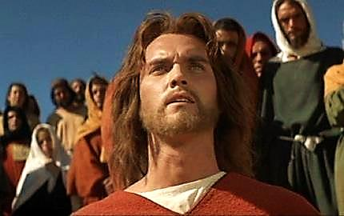
The Real Jesus (Bilingual: English & Turkish)

Slide 2
Note: Any videos in this presentation will only play online. After you download the slideshow, you will need to also download the videos from YouTube & add them back into your PowerPoint.
We present these messages at Bee Creek Park in College Station, TX. If you would like to watch the video of the service with this message, click here:
http://campaignkerusso.org/?p=10929
We would love to know more about the people who download our lessons & sermons. We invite you to email us & let us know where & how you use them.
info@ckbrazos.org

Slide 3
WHERE DID HE COME FROM?
WHO WAS HE?
WHAT WAS HIS MISSION?
WHAT HAPPENED TO HIM?

Slide 4
WHERE DID HE COME FROM?
Next Slide: Video – More than a Prophet – English
Download Here:
http://youtu.be/rU1K9oS0ZCc

Slide 5
WHERE DID HE COME FROM?
Next Slide: Video – More than a Prophet – Turkish
Download Here:
http://youtu.be/bM7tHVG3ma4

Slide 6
WHO WAS HE?
Next Slide: Video – Peter Declares Jesus to be the Christ - English
Download Here:
http://youtu.be/7zMcOJWUEag

Slide 7
WHO WAS HE?
Next Slide: Video – Peter Declares Jesus to be the Christ - Turkish
Download Here:
http://youtu.be/fnO_onoIdW8

Slide 8
WHAT WAS HIS MISSION?
Next Slide: Video – Death of Jesus English
Download Here:
http://youtu.be/m79_AWYlch8

Slide 9
WHAT WAS HIS MISSION?
Next Slide: Video – Death of Jesus Turkish
Download Here:
http://youtu.be/URyW5v7rYZw

Slide 10
WHAT HAPPENED TO HIM?
Next Slide: Video – Resurrected Jesus Appears to His Disciples – English
Download Here:
http://youtu.be/pGIEE_LW2T4

Slide 11
WHAT HAPPENED TO HIM?
Next Slide: Video – Resurrected Jesus Appears to His Disciples – Turkish
Download Here:
http://youtu.be/ljw0hReaab0

Slide 12
WHAT DO WE DO WITH JESUs
Next Slide: Video –Invitation to Know Jesus Personally – English
Download Here:
http://youtu.be/rAgrFN1HkxQ

Slide 13
WHAT DO WE DO WITH JESUS?
Next Slide: Video –Invitation to Know Jesus Personally – Turkish
Download Here:
http://youtu.be/rKk7JMrifd0

Slide 14
Is Jesus Speaking to You?
“They said to each other, ‘Did not our hearts burn within us while he talked to us on the road, while he opened to us the Scriptures?’”
John Wesley Said:
“…the preacher was describing the change which God works in the heart through faith in Christ and I felt my heart strangely warmed.”
Jesus makes His presence Known by a small voice!

Slide 16
What is the Sinner‘s Prayer?
This is a prayer we can pray when we are ready to admit we are sinners and need Christ’s forgiveness.
It must be prayed with faith in our hearts and a readiness to have a life-changing encounter with Jesus Christ.

Slide 17
A prayer of faith → Pray this prayer if :
If you never have before
You have in the past, but you think it would mean more today
You have been walking afar off and you want to come back
You want to set an example & show others how it is done
You just like to give your heart to Jesus again & again
Faith

Slide 18
We Declare Our Faith Publicly Because Jesus Declared His LOVE Publicly
“If you stand before others and are willing to say you believe in me, then I will tell my Father in heaven that you belong to me.” Mat 10:32

Slide 19
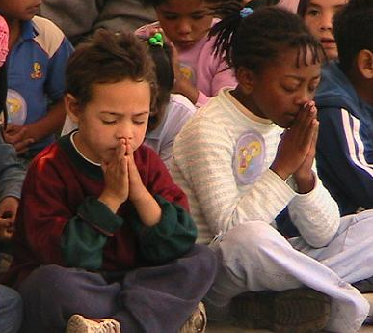
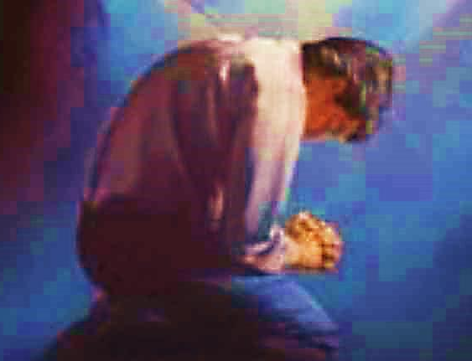
Important Questions
Do you want to know Jesus as your Savior right now?
Do you believe He died to save you from your sins & that He rose from the dead?
Do you believe that He is here, waiting to save you right now?

Slide 20
The Prayer of a Sinner Turning to Jesus
Dear Jesus, I know that I have sinned against You and that my sins separate me from You.
I am truly sorry.
Right now, I turn away from my sinful past .
Please forgive me, and help me to keep from sin.
I believe You died for my sins.
I Believe You rose from the dead, you are alive, and you hear this prayer from my heart.
I invite You Jesus to be both my Savior and the Lord of my life.
I want You to rule my life from now on.

Slide 21
“But some people did accept him. They believed in him, and he gave them the right to become children of God.”
John 1:12

Slide 23
“If you openly say, ‘Jesus is Lord’ and believe in your heart that God raised him from death, you will be saved.”
Rom. 10:9
What did you learn today?
What is the meaning of the name-tag?
What have you been thinking about God lately?
What do you want to tell the world about Jesus?

Slide 24
“Draw near to God, and He will draw near to you…
Altar Time
…Cleanse your hands, you sinners, and make your hearts pure, you who are half-hearted towards God.” James 4:8 WNT

Slide 25
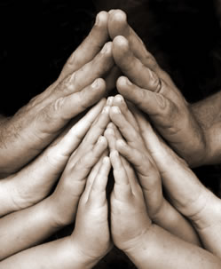
Close in Prayer

Slide 26
Note: Any videos in this presentation will only play online. After you download the slideshow, you will need to also download the videos from YouTube & add them back into your PowerPoint.
We present these messages at Bee Creek Park in College Station, TX. If you would like to watch the video of the service with this message, click here:
http://campaignkerusso.org/?p=10929
We would love to know more about the people who download our lessons & sermons. We invite you to email us & let us know where & how you use them.
info@ckbrazos.org

Slide 27
Welcome to Aggieland Faith Family Style Worship

Slide 28
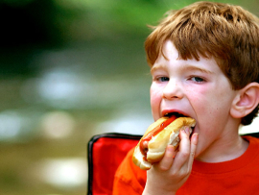
CURRENT SCHEDULE: See www.Aggielandfaith.org
SUNDAY —
At Bee Creek Park
2:00-5pm: Free snacks, drinks, kids crafts, prizes, singing & bible preaching

Slide 29
Would You Like Prayer or Bible Study at Your House?
Personal Prayer: We can come to your home & pray with you, or you can email us when you need prayer.
Home Bible Study: We will come to your home & hold a bible study for you & your friends.
Bible Party: We will hold a Kid’s Bible Party: You provide the food & kids - we will do the bible fun & stories.

Slide 30
Would You Like Visitation?
We will visit a friend, loved one in the hospital or in prison to pray for them & share Christ with them.
Contact: info@aggielandfaith.org

Slide 31
www.aggielandfaith.org
Go here to see pictures & videos
Go here to subscribe to e-mails about changes & cancellations

Slide 32
Note: Any videos in this presentation will only play online. After you download the slideshow, you will need to also download the videos from YouTube & add them back into your PowerPoint.
We present these messages at Bee Creek Park in College Station, TX. If you would like to watch the video of the service with this message, click here:
http://campaignkerusso.org/?p=10929
We would love to know more about the people who download our lessons & sermons. We invite you to email us & let us know where & how you use them.
info@ckbrazos.org

